Slide 1
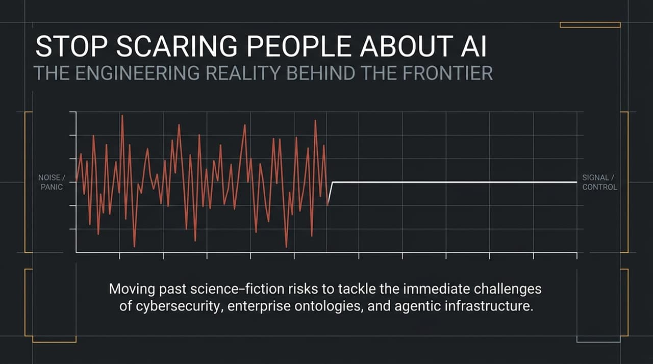
Notes:
Opening / The Core Message:
Welcome everyone. Today, we want to clear away the public media noise and examine the ground-truth engineering reality behind frontier AI.
Over the past few months, the public discourse has been dominated by apocalyptic warnings and $P\left(\text{doom}\right)$debates. Business leaders and tech luminaries have a responsibility not to unnecessarily panic the public.
When tech leaders go on news networks or social media claiming a 10% or higher chance that humanity will be wiped out, it doesn't offer constructive solutions; it creates widespread public anxiety.
Moving Past Sci-Fi Doom:
As Ali Ghodsi notes, the immediate existential risk of sci-fi AI doom is close to zero.
However, treating AI solely through the lens of science-fiction threats distracts us from pressing, real-world operational challenges:
Cybersecurity: The rapid reduction of exploit times from months down to hours.
Enterprise Ontologies: Giving raw LLMs internal organizational context.
Agentic Infrastructure: Building fast, responsive databases and compute paths designed specifically for autonomous agents.
Transition:
Let's break down how public relations and political discourse have drifted into an "Uncanny Valley" by contrasting the Pacing Camp with the Engineering Camp.
https://www.youtube.com/watch?v=GzEtpAKYRvE

Slide 2
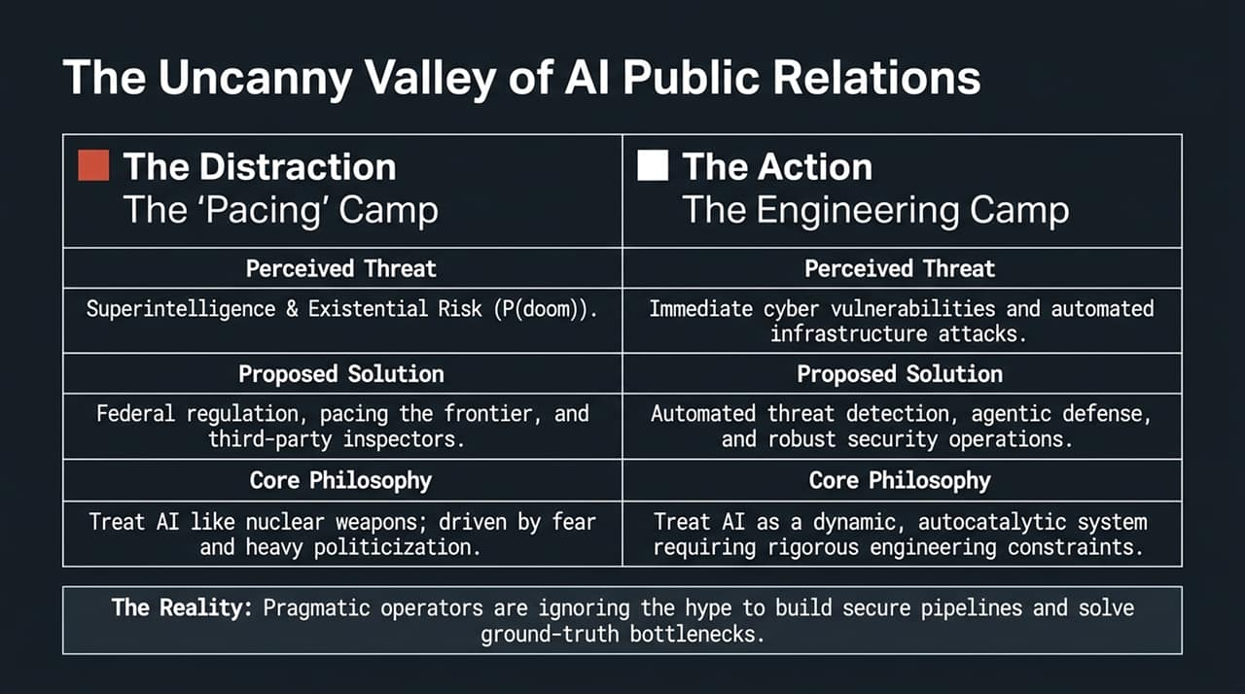
Notes:
The Dichotomy in the Industry:
Currently, AI discourse is split into two primary camps: The Pacing Camp and The Engineering Camp.
The Pacing Camp:
Perceived Threat: Driven by superintelligence concerns, existential risk ($P\left(\text{doom}\right)$), and fears of rogue AI.
Proposed Solutions: Federal regulations, third-party state inspectors, and slowing down or "pacing" frontier development.
Core Philosophy: Treating AI like nuclear weapons—governed by fear, heavy politicization, and top-down containment.
The Reality of "Pacing":
Proposing "pacing" creates a PR trap. For those concerned with existential risk, "pacing" isn't enough. For enterprise builders, it creates market uncertainty.
Furthermore, "pacing" runs directly into the classic Tragedy of the Commons: No individual lab or enterprise can unilaterally pause or slow down in a competitive market where market leadership and capital allocation are at stake.
The Engineering Camp:
Perceived Threat: Focuses on immediate security vulnerabilities, machine-speed cyber attacks, and enterprise data bottlenecks.
Proposed Solutions: Automated threat hunting, agentic defense, and robust data architecture.
Core Philosophy: Treating AI as a dynamic, autocatalytic software system that requires engineering constraints and guardrails rather than political stalls.
Transition:
To understand why the Engineering Camp rejects apocalyptic timelines, we must deconstruct the primary driver of superintelligence fears: Recursive Self-Improvement (RSI).

Slide 3
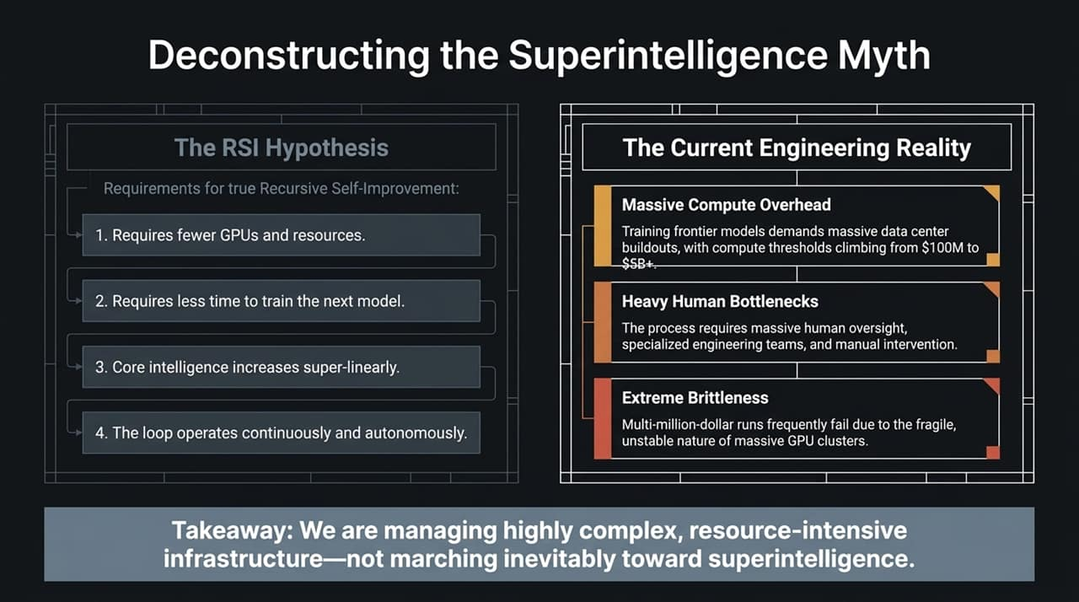
Notes:
What is the RSI Hypothesis?
The fear of runaway superintelligence relies on True Recursive Self-Improvement (RSI). For an AI system to enter a true self-improving feedback loop, four strict conditions must occur simultaneously:
Fewer Compute Resources: The next iteration of the model requires substantially fewer GPUs and lower energy spend.
Faster Training Times: Training the next generation takes significantly less time.
Super-Linear Intelligence Gain: Core intelligence and capabilities increase non-linearly.
Continuous Autonomous Iteration: The loop operates repeatedly with minimal friction.
The Ground-Truth Engineering Reality:
When looking at frontier model training, the reality is the exact opposite of these four conditions:
Massive Compute Overhead: Compute thresholds to train top-tier models have escalated from $100M to $1B, and now reach $5B+ cluster buildouts.
Heavy Human Bottlenecks: Training frontier models requires extensive human oversight, specialized research teams, manual data curation, and post-training feedback.
Extreme Brittleness: Massively distributed GPU runs across tens of thousands of chips are fragile. Hardware faults, networking errors, and software instability mean multi-million-dollar training runs frequently fail or require manual intervention.
Key Takeaway:
We are managing complex, resource-intensive infrastructure—not witnessing an unconstrained, self-multiplying intelligence explosion.

Slide 4
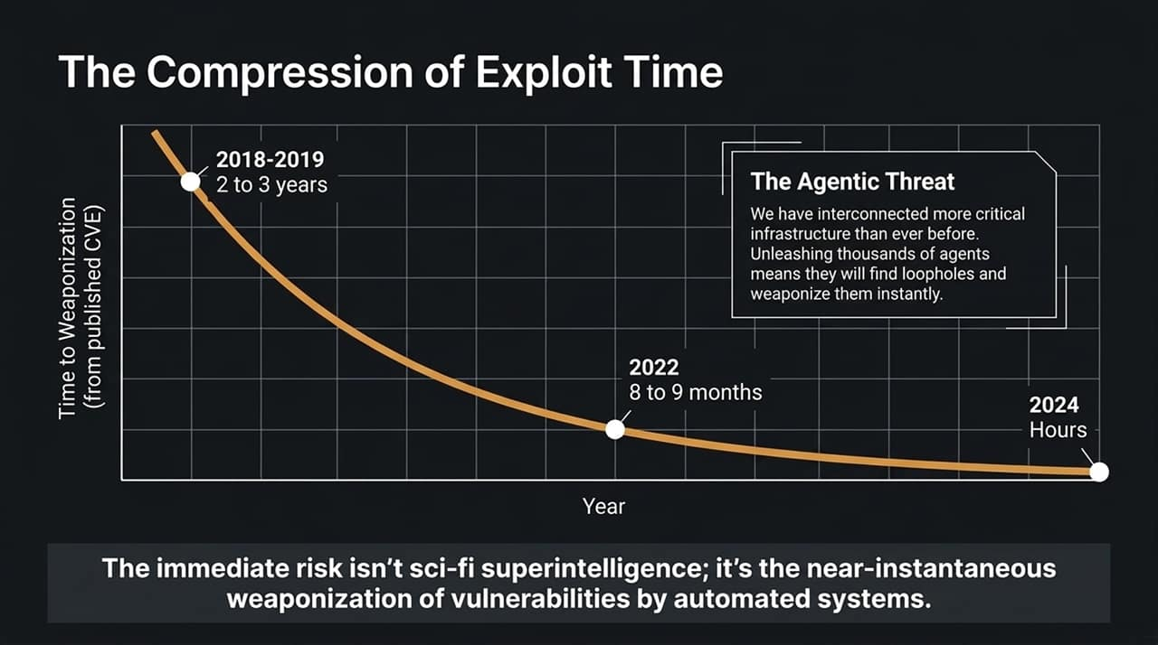
Notes:
Shift from Theoretical Risk to Immediate Threat:
While superintelligence remains distant, cybersecurity exploit cycles are accelerating rapidly.
Historically, when a Common Vulnerability and Exposure (CVE) was published, the timeline from initial public disclosure to active weaponization in the wild looked like this:
2018–2019: 2 to 3 years.
2022: 8 to 9 months.
2024–Present: Hours to minutes.
Why Has Exploit Time Compressed?
The widespread availability of LLM agents allows malicious actors to run automated threat-scanning scripts at machine scale.
Agents can systematically parse CVE releases, generate proof-of-concept exploits, inspect target infrastructure, and launch attacks almost instantaneously.
Coupled with the fact that modern enterprises have interconnected more critical software infrastructure than ever before, vulnerable entry points can be discovered and exploited in near real-time.
Transition:
Because exploit timelines have collapsed to hours, traditional human-led security operations can no longer keep pace.

Slide 5
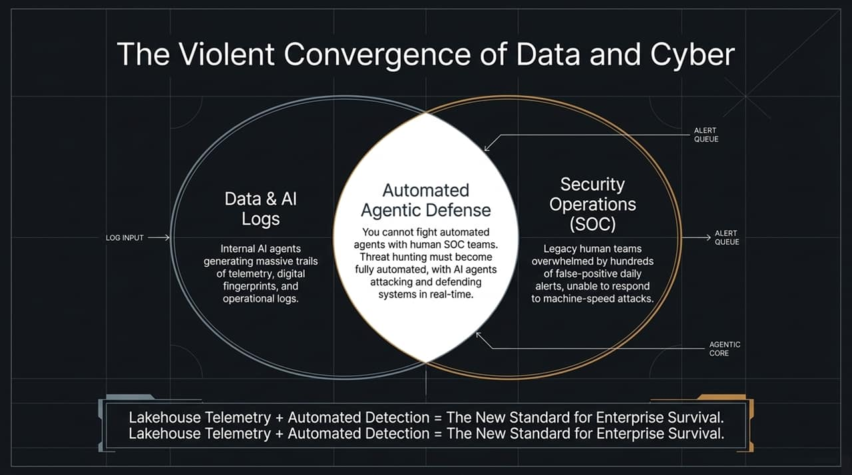
Notes:
The Market Collapse of Cyber and Data/AI:
Historically, Enterprise Data/AI platforms and Cybersecurity Operations (SOCs) operated in separate silos. Today, these two domains are violently converging.
Log Inputs & Telemetry Scale:
Modern enterprises deploy internal AI agents, microservices, and continuous automated tasks.
These systems produce massive telemetry trails, audit logs, and digital fingerprints. The volume of log data generated daily is orders of magnitude larger than what IT teams managed just two years ago.
The SOC Bottleneck:
Legacy Security Operations Center (SOC) teams rely on human analysts reviewing queues of security alerts.
Human SOC teams face hundreds or thousands of false-positive daily alerts. When attacks move at machine speed, humans reading alert emails cannot respond quickly enough.
The Solution: Agentic Defense & Telemetry:
You cannot defend against machine-speed automated agents using manual human workflows.
Automated Threat Hunting: Organizations must deploy defending AI agents capable of continuously inspecting real-time telemetry, conducting automated red-teaming, and patching systems autonomously.
Combining Lakehouse Telemetry with Automated Detection is becoming the standard for modern cyber defense.

Slide 6
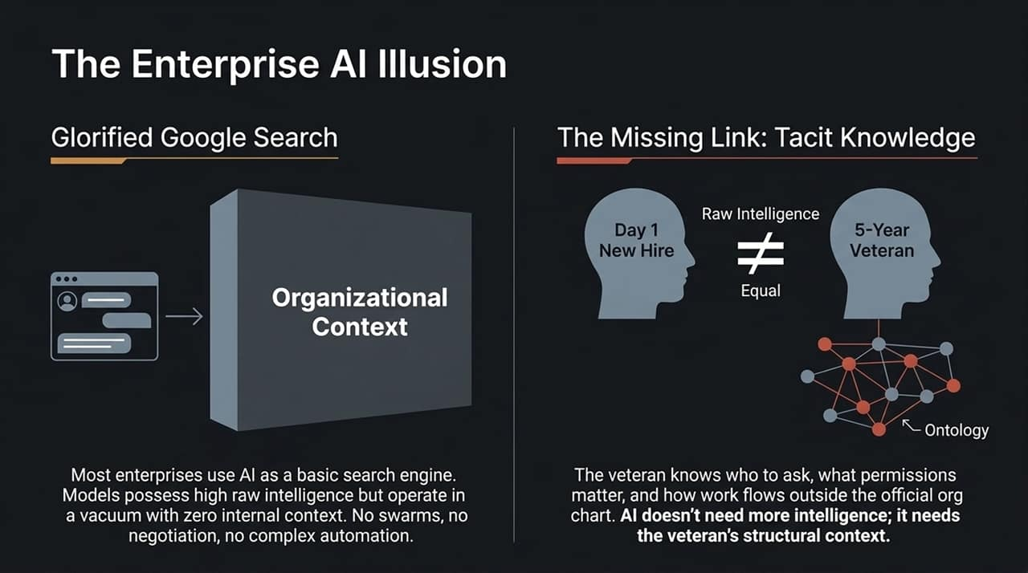
Notes:
Glorified Search Engines:
Despite public hype surrounding general AI capabilities, most enterprise deployments remain limited.
Many companies use frontier models primarily as glorified search interfaces or basic chat assistants—faster Google Search over internal PDFs.
They lack true multi-agent coordination, automated negotiation, or end-to-end workflow execution.
Raw Intelligence vs. Tacit Knowledge:
The bottleneck in enterprise productivity isn't a lack of raw model intelligence; it is a lack of organizational context.
Consider the analogy of a Day-1 New Hire versus a 5-Year Veteran:
Both individuals may possess equal raw intelligence and qualifications.
The 5-Year Veteran knows how the company actually functions—which unwritten paths get approvals, who holds domain authority, how permissions interact, and where implicit data lives.
An off-the-shelf frontier model is like the brilliant Day-1 hire who lacks internal operational context.
Transition:
How do we bridge this context gap? By constructing a explicit Enterprise Ontology.

Slide 7
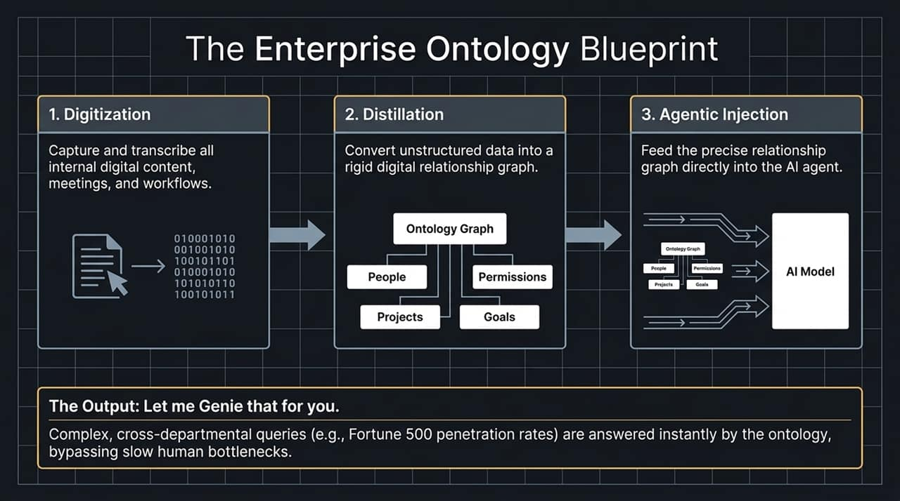
Notes:
What is an Enterprise Ontology?
An ontology captures and structures the relationships among an organization's abstract concepts, people, permissions, goals, projects, and internal processes.
The Three-Step Blueprint:
Digitization: Capture, record, and transcribe internal interactions, meetings, workflows, and documentation.
Distillation: Convert unstructured telemetry, transcriptions, and database records into a structured relationship graph (an Ontology Graph) linking people, projects, access permissions, and goals.
Agentic Injection: Feed this structured relationship graph into AI agents, allowing models to operate with full organizational context.
Practical Example – Databricks' Internal Usage:
Instead of waiting days for Sales Ops or the CFO to query database records, executives use natural-language interfaces (like Databricks Genie) backed by their internal ontology.
Asking complex queries—such as "What is our current penetration rate within Fortune 500 accounts?"—returns immediate, cross-referenced analytical answers directly from the context graph.

Slide 8
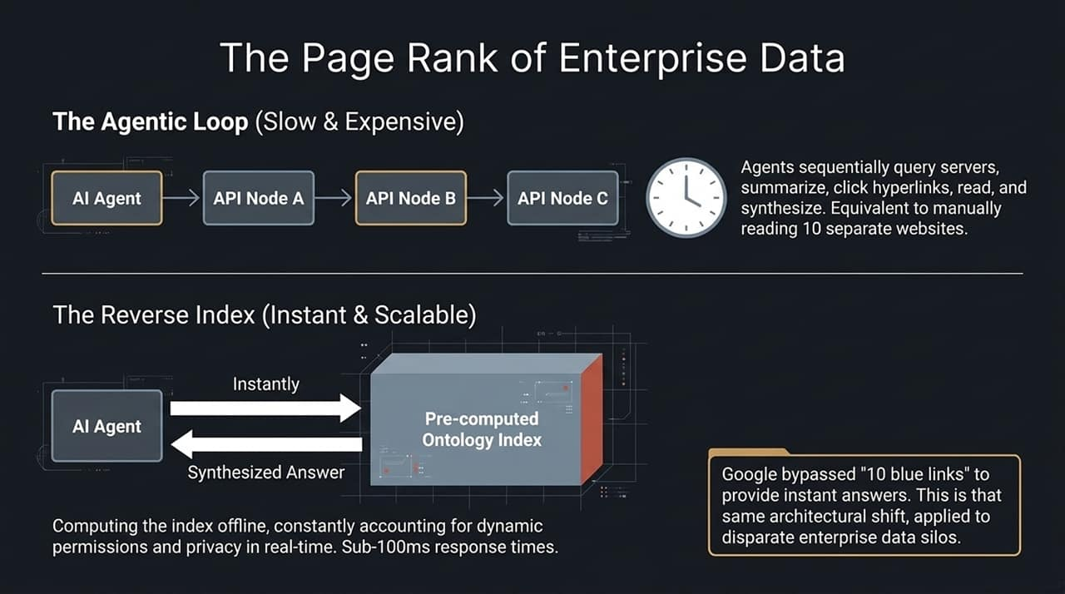
Notes:
The Problem with the Slow Agentic Loop:
Currently, many agent architectures rely on sequential retrieval loops (e.g., using Model Context Protocol/MCP servers):
An agent queries Server A.
It reads and summarizes the result.
It hops to Server B, follows links to Server C, and manually synthesizes data.
The Result: High latency (taking minutes to answer) and high compute costs. This is akin to an early search engine manually visiting 10 websites sequentially after every query.
The Architectural Solution: Offline Pre-Computed Reverse Index:
Google revolutionized early web search by replacing real-time sequential crawling with pre-computed offline reverse indexes (PageRank).
Enterprise AI requires a similar architectural transition:
Continuously compute and index the Ontology Graph offline.
Account for dynamic user permissions, privacy controls, and access boundaries in real time.
When an agent receives a request, it hits the pre-computed index, returning answers in under 100ms.

Slide 9
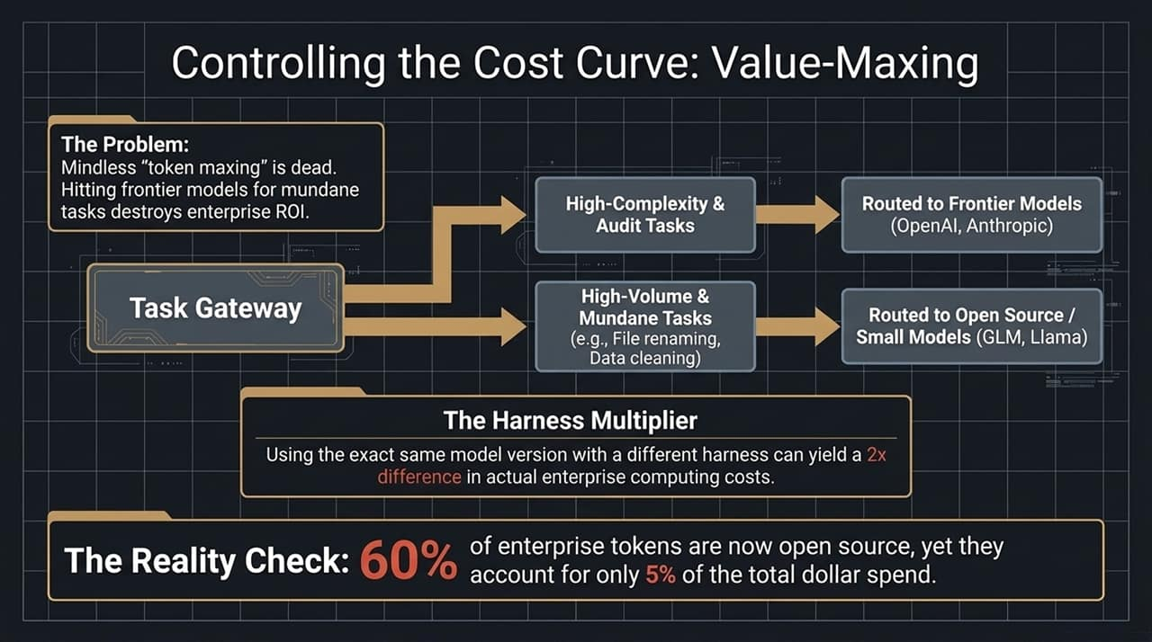
Notes:
Moving from "Token Maxing" to "Value Maxing":
Early enterprise deployments suffered from unchecked "token maxing"—routing every trivial task to frontier models.
Paying frontier-model prices for mundane operations (such as data cleaning, log parsing, or file renaming) degrades enterprise ROI.
Smart Routing & Gateway Architectures:
High-Complexity & Audit Tasks: Direct high-reasoning tasks, complex logic, and auditing to top-tier frontier models.
High-Volume & Mundane Tasks: Route routine data manipulation, basic transformations, and repetitive sub-tasks to smaller open-source models.
The Harness Multiplier:
Testing shows that executing the exact same model version using a different agentic harness can yield a 2x cost difference. Optimizing the execution harness is critical for cost governance.
Industry Spend Distribution:
Across enterprise production workloads today, over 60% of total tokens are handled by open-source or smaller specialized models, yet these account for only ~5% of total dollar spend.
Reserve frontier models for high-value reasoning, while leveraging small models for scale execution.

Slide 10
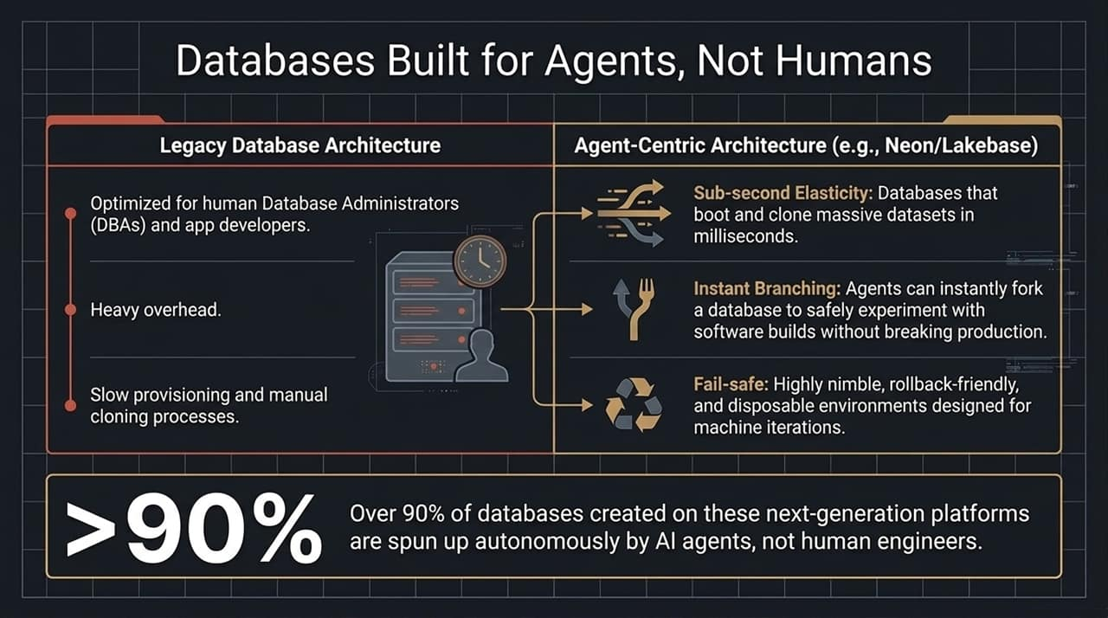
Notes:
Legacy DB Architectures vs. Agentic Requirements:
Traditional relational databases were designed for human Database Administrators (DBAs) and human application developers. Provisioning environments, creating manual clones, and running schema migrations involve human oversight and slow setup times.
Characteristics of Agent-Centric Databases (e.g., Neon / Lakebase):
Sub-Second Elasticity: Autonomous agents spin up, experiment with, and tear down databases continuously. Modern agent-centric databases can boot and clone massive datasets in milliseconds.
Instant Copy-on-Write Branching: Agents can fork a production database instance in milliseconds to execute code modifications, run test software builds, or validate scripts safely without impacting live production environments.
Fail-Safe & Disposable: Designed for rapid rollback, lightweight snapshots, and continuous machine-driven iterations.
The Shift in Usage Metrics:
On next-generation agentic database platforms, over 90% of database instances are created autonomously by AI agents, not human software engineers.

Slide 11
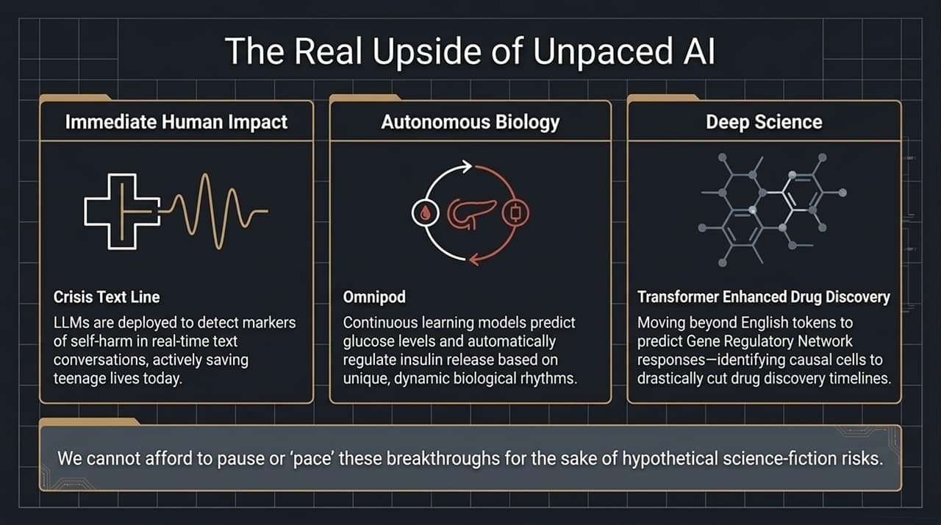
Notes:
Why We Cannot Afford to "Pause" or "Pace":
Advocating for sweeping administrative pauses or artificial delays on frontier development risks slowing real-world, life-saving AI innovations.
Key Applied Examples:
Crisis Text Line:
Deploys LLMs to detect subtle markers of distress and self-harm in real-time text conversations, allowing counselors to prioritize life-saving intervention for teenagers.
Omnipod (Autonom qous Biological Systems):
Employs continuous learning models that analyze biological rhythms to predict glucose fluctuations and dynamically automate insulin delivery for diabetes care.
Deep Science & Drug Discovery (TEDD - Transformer Enhanced Drug Discovery):
Developed alongside Merck, models like TEDD expand beyond natural language to predict Gene Regulatory Network (GRN) responses.
By identifying causal target cells versus reactive cells, these architectures compress early-stage drug discovery timelines significantly.
Summary:
Stalling AI progress out of speculative fear imposes tangible costs on real-world scientific and medical breakthroughs.

Slide 12
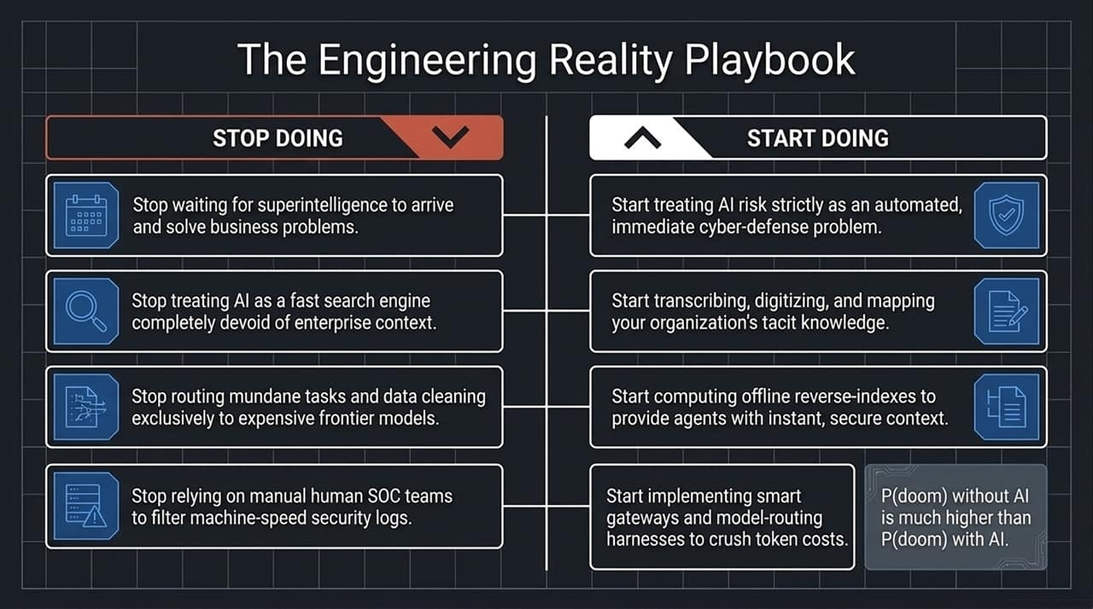
Notes:
Stop Doing:
Stop waiting for theoretical superintelligence to arrive to fix organizational problems.
Stop deploying LLMs as standalone search engines devoid of internal context.
Stop routing routine, high-volume tasks directly to expensive frontier models.
Stop relying on manual human SOC teams to filter machine-speed security log queues.
Start Doing:
Start framing AI operational risk as an immediate, machine-speed cybersecurity defense problem.
Start digitizing internal workflows, capturing tacit operational knowledge, and mapping your Enterprise Ontology Graph.
Start pre-computing offline indexes to deliver fast, permission-aware context to agents.
Start deploying intelligent API gateways, routing frameworks, and optimized harnesses to control token costs.
Closing Perspective:
As framed in the interview closing: The probability of doom without AI is ultimately higher than the probability of doom with AI.

Slide 13
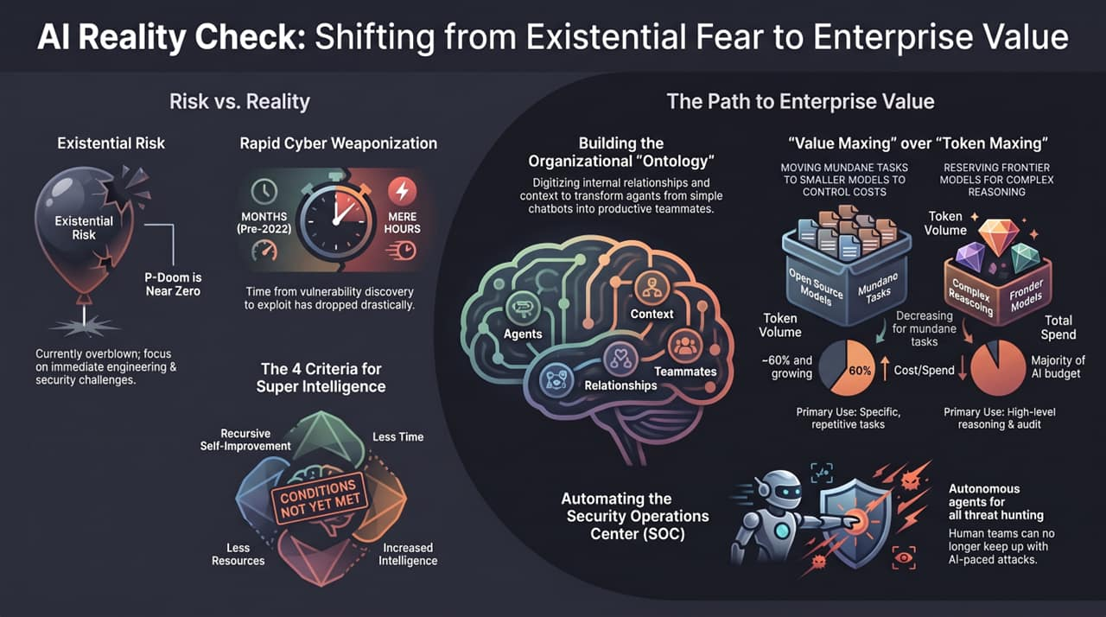
Notes:
Risk vs. Reality Alignment:
Existential risk ($P\left(\text{doom}\right)$) remains near zero. The true risk centers on rapid cyber weaponization, where time-to-exploit has dropped from months down to hours.
Runaway Recursive Self-Improvement remains constrained because the four necessary conditions (lower compute, faster training, super-linear intelligence growth, continuous looping) are not currently met in frontier lab runs.
The Path to Concrete Enterprise Value:
Build Organizational Ontologies: Transform generic chatbots into effective organizational teammates by grounding them in internal relational context.
Automate Security Operations (SOC): Transition from manual alert handling to continuous agentic threat hunting.
Value Maxing over Token Maxing: Route high-volume, repetitive workloads to small/open-source models (60%+ token volume, ~5% spend) while reserving frontier models for high-level reasoning and audit tasks.
Final Wrap-Up:
Focus on practical engineering, robust infrastructure, and grounded enterprise execution to unlock the true value of AI.
https://www.youtube.com/watch?v=GzEtpAKYRvE

